Slide 1
PHYSICAL LAYER
COMPUTER NETWORKS

Slide 2
Chapter 2: roadmap
2.1. Introduction
Packet encapsulation
Basic for data communication
2.2. Functionality
2.3. Physical layer communication media
2.3.1. Wired
2.3.2. Wireless
2.4. Line coding
2.5 Multiplexing/De-multiplexing

Slide 3

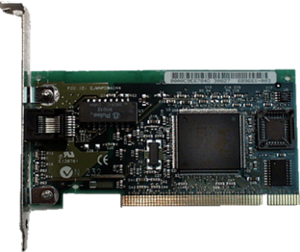
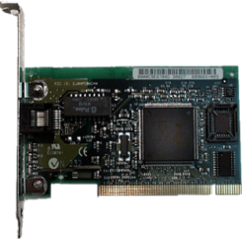
2.1 Introduction
Application
Application
Presentation
Data
Presentation
Session
Session
Transport
segments
Transport
Data
Network
packets
Network
Data
Data Link
frames
Data Link
Data
Physical
Physical
10010111001011010010110101011110101

Slide 4
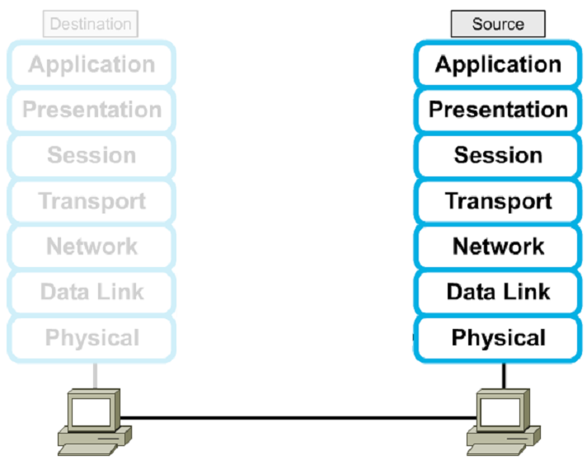



2.1.1. Encapsulation

Slide 5
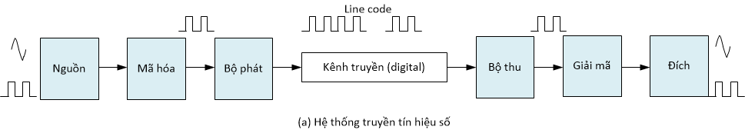
2.1.2. Basic for data communication
Relevant matters
How to convert information into digital data.
Types of transmission channels.
How to connect communication devices.
How to transmit a bit from the sending device to the receiving device.

Slide 6
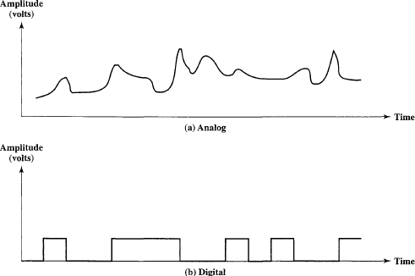


Time Domain Concepts
Analog / Digital
Analog signal - signal intensity varies in a smooth fashion over time
No breaks or discontinuities in the signal
Digital signal - signal intensity maintains a constant level for some period of time and then changes to another constant level
Wireless and Mobile Networks
13

Slide 7
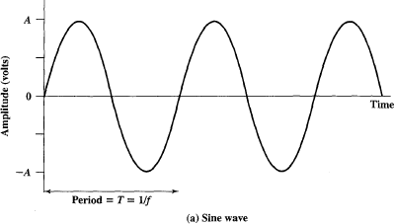
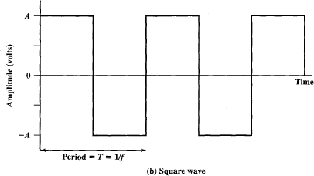

Time Domain Concepts
Periodic / Aperiodic
Periodic signal - analog or digital signal pattern that repeats over time
s(t +T ) = s(t ) -∞< t < +∞
where T is the period of the signal (the smallest value that satisfies the equation )
Aperiodic signal - analog or digital signal pattern that doesn't repeat over time
Wireless and Mobile Networks
14

Slide 8
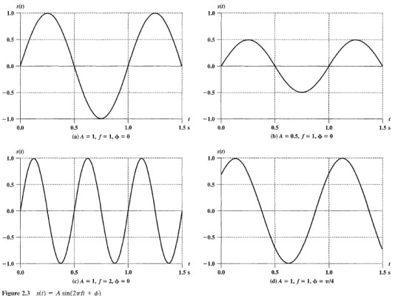
Time Domain Concepts
Sine Wave (sinusoid)
A fundamental analog (periodic) signal
Can be represented by three parameters
Peak Amplitude (A)
Frequency (f)
Phase (Φ)
s(t ) = A sin(2πft + φ)
Period: T = 1/f
The figure shows the effect of
varying each of the three parameters:
A = 1, f = 1 Hz, φ = 0; thus T = 1s
Reduced peak amplitude; A=0.5
Increased frequency; f = 2, thus T = ½
Phase shift; φ = π/4 radians (45 degrees)
Wireless and Mobile Networks
15

Slide 9
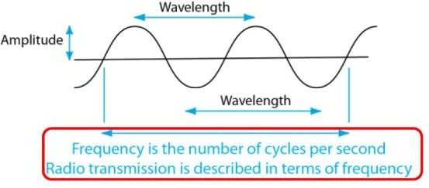
Time Domain Concepts
Wavelength (λ) - distance occupied by a single cycle of the signal
Electromagnetic waves travel at the speed of light (c)
c= λf
c: speed of light in free space = 3 x 10⁸ m/s
f: signal frequency (Hz)
λ: wave length (m)
https://www.toppr.com/guides/physics-formulas/wavelength-frequency-formula/
Wireless and Mobile Networks
16

Slide 10
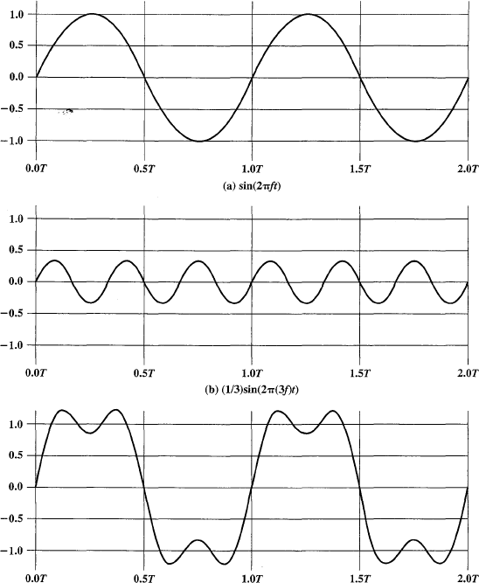
Frequency Domain Concepts
In practice, an electromagnetic signal is made up of many frequencies.
Fourier Analysis
o Any signal is made up of components at various frequencies, in which each component is a sinusoid.
Fundamental frequency - when all frequency components of a signal are integer multiples of one (the lowest) frequency, it’s referred to as the fundamental frequency
The period of the total signal is equal to the period of the fundamental frequency
Wireless and Mobile Networks
17

Slide 11
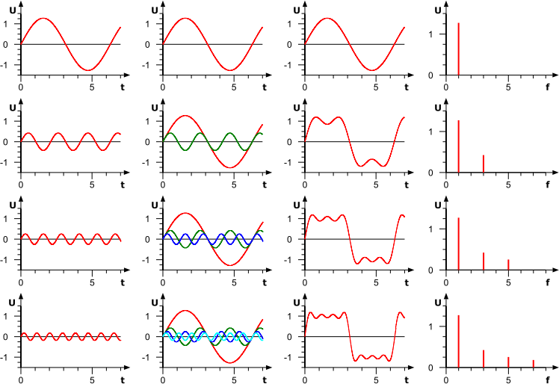
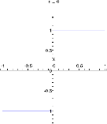
Frequency Domain Concepts
f
3f
5f
7f
Wireless and Mobile Networks
18

Slide 12
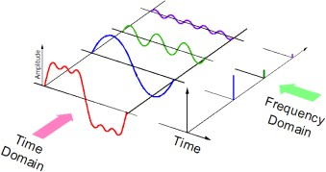
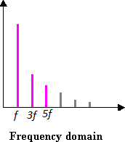
Frequency Domain Concepts
Spectrum - range of frequencies that a signal contains
Absolute Bandwidth - width of the spectrum of a signal = f_{MAX} - f_{Min}
Many Signals have an infinite bandwidth but most of the energy is contained in a relatively narrow band of frequencies
Effective Bandwidth (or just bandwidth) - narrow band of frequencies that most of the signal’s energy is contained in.
e.g. Voice Signal (20 Hz to 20 kHz) we use only (300Hz to 3.4 KHz)
Example
Fundamental Freq =
Max_Freq =
BW =
Wireless and Mobile Networks
19

Slide 13
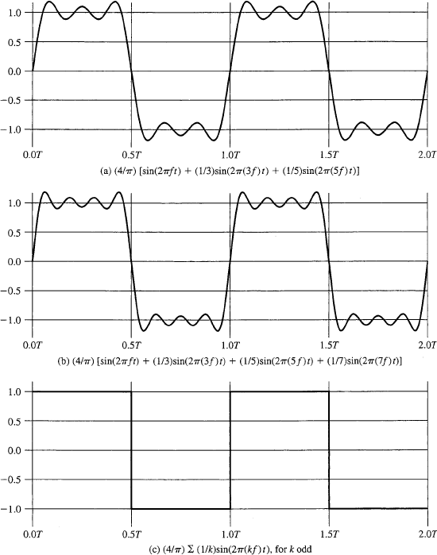

Relationship Between Data Rate and Bandwidth
Data Rate - rate at which data can be communicated (bps = bits per second)
Consider the square wave shown in the figure
Suppose that the positive pulse represent binary 0, and the negative pulse represent binary 1.
The data rate = 2 x f bits per second (bps)
This waveform consists of infinite number of frequency components and hence an infinite bandwidth.
Wireless and Mobile Networks
20

Slide 14
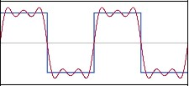
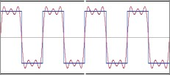
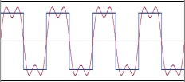
Relationship Between Data Rate and Bandwidth
Case-I
o Assume a signal has the following components: f, 3f, 5f; f= 1 MHz
o What is the BW?
BW= 5f–f = 4f = 4MHz
o What is the Data Rate? Data Rate = 2 Mbps
Case-II
o Assume a signal has the following components: f, 3f, 5f; f= 2 MHz
o What is the BW?
BW= 5f–f = 4f = 8MHz
o What is the Data Rate? Data Rate = 4 Mbps
Case-III
o Assume a signal has the following components: f, 3f; f= 2 MHz
o What is the BW?
BW= 3f–f = 2f = 4MHz
o What is the Data Rate? Data Rate = 4 Mbps
Conclusions
Any digital waveform will have infinite bandwidth
BUT the transmission system will limit the bandwidth that can be transmitted
AND, for any given medium, the greater the bandwidth transmitted, the greater the cost
HOWEVER, limiting the bandwidth creates distortions
Wireless and Mobile Networks
21

Slide 15
Data Communication Terms
Data - entities that convey meaning, or information
Signals - electric or electromagnetic representations of data
Transmission - communication of data by the propagation and processing of signals
Examples of Analog and Digital Data
Analog
Video
Audio
Digital
Text
Integers
Both analog and digital data can be represented, and hence propagated, by either analog or digital signals
Wireless and Mobile Networks
22

Slide 16
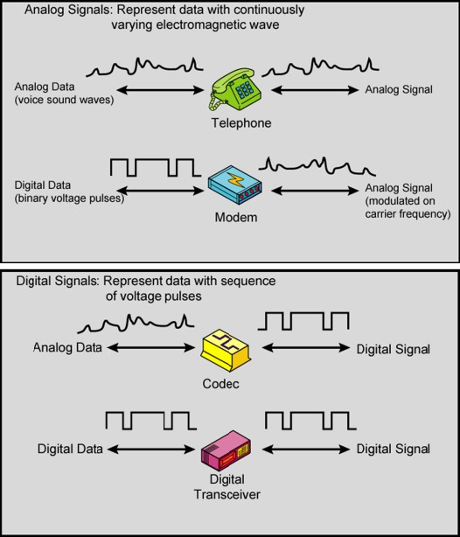
Analog and Digital Data Transmission
Wireless and Mobile Networks
23

Slide 17
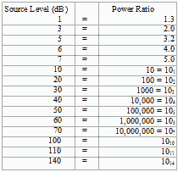
Decibel Notation
What is dB (decibel):
A logarithmic unit that is used to describe a ratio.
If we have two values P1 and P2. The ratio between them can be expressed in dB
and is computed as follows:
10 log (P2/P1) dB
Example: transmit power P1=1W, received power P2=100W
The ratio is 10log(100/1) = 20dB.
dB unit can describe very big ratios with numbers of modest size.
Example: transmit power = 100W, Received power = 1mW
Transmit power is 100,000 times of received power
Ratio (Transmit/Received) is 50dB
Wireless and Mobile Networks
24

Slide 18
dBm and dBW
For power, dBm is used to denote a power level with respect to 1mW as the reference power level.
Let’s say that a transmit power of a system is 100W.
Question: What is the transmit power in unit of dBm?
Answer: transmit power(dBm) = 10log(100W/1mW) = 10log(100,000mW/1mW) = 50dBm
For power, dBW is used to denote a power level with respect to 1W as the reference power level.
Let say transmit power of a system is 100W.
Question: What is the transmit power in unit of dBW?
Answer: transmit _power(dBW) = 10log(100W/1W) = 10log(100) = 20dBW.
Wireless and Mobile Networks
25

Slide 19
Channel Capacity
Channel Capacity: the maximum rate at which data can be transmitted over a given channel, under given conditions.
Noise: any unwanted signal that combines with and hence distorts the signal intended
for transmission and reception.
Error Rate: This is the rate at which errors occur, where an error is the reception of a 1 when a 0 was transmitted or the reception of a 0 when a 1 was transmitted.
The Nyquist Limit
o A noiseless channel of bandwidth B Hz can at most transmit a binary signal at a
capacity
C = 2B bps
e.g. a 3000 Hz channel can transmit data at a rate of at most 6000 bits/second
What if the number of signal levels is more than 2 (M levels):
C = 2B log₂(M) bps
e.g. a 3000 Hz channel, with 8 discrete signal elements, can transmit data at a rate of at most 18000 bits/second
For a given bandwidth, the capacity can be increased by increasing the number of different signal elements (M)
Increasing M, increases receiver sensitivity to noise and other channel impairments.
Wireless and Mobile Networks
26

Slide 20
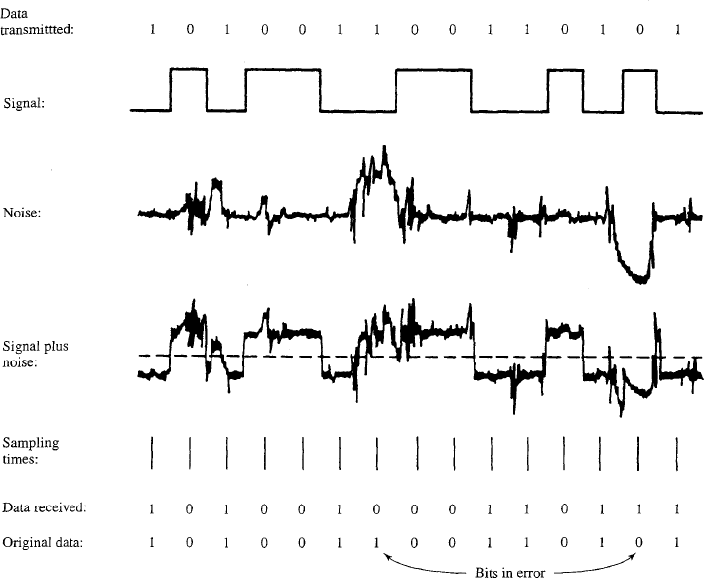
Channel Capacity
The presence of noise can corrupt one or more bits. If the data rate is increased, then the bits become "shorter" in time, so that more bits are affected by a given pattern of noise. Thus, at a given noise level, the higher the data rate, the higher the error rate.
For a given level of noise, we would expect that a greater signal strength would improve the ability to receive data correctly in the presence of noise
Wireless and Mobile Networks
27

Slide 21
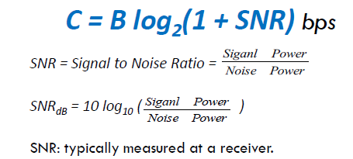
Channel Capacity
Represents theoretical maximum channel capacity that can be achieved
In practice, only much lower rates can be achieved
Formula assumes white noise (thermal noise)
Impulse noise is not accounted for
Attenuation distortion or delay distortion not accounted for
We can also use Shannon’s theorem to calculate the noise that can be tolerated to achieve a certain rate through a channel.
Wireless and Mobile Networks
28

Slide 22
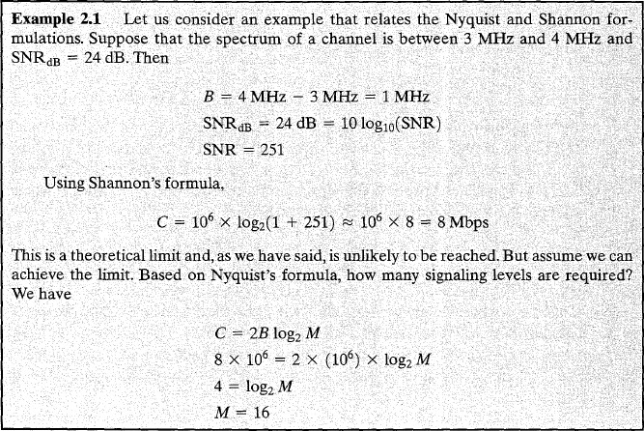
Channel Capacity
Wireless and Mobile Networks
29

Slide 23
2.2. Functionality of Physical layer
The physical layer involves the transmission of raw data bits on the transmission channel.
Amplitude, Frequency, Phase, Bandwidth, Spectrum
Data rate, throughput, delay (latency)
It is required is a transmission mechanism, interface, voltage level, that are compatible with the transmission media below.
Wired
Wireless

Slide 24
Transmission media
Wired transmission (Guided)
Twisted pairs
Coaxial
Fibre
Wireless transmission
Radio
Microwave
Infrared
Optical

Slide 25
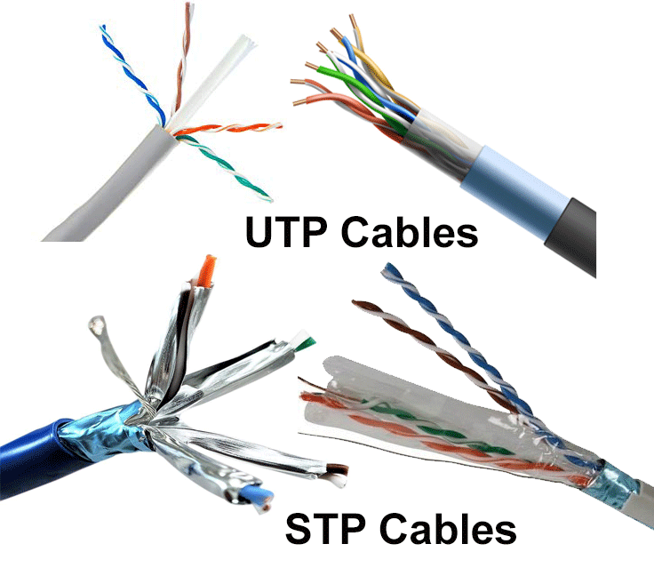
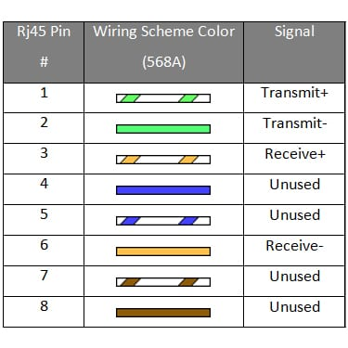
Twisted-pair cable
A twisted-pair cable consists of two insulated copper wires, typically about 1 mm thick, twisted to avoid crossover talk (interference). It is classified into 2 types:
Unshield Twisted Pair (UTP)
Shield Twisted Pair (STP)
Notes:
Twisting is done because two parallel wires constitute a fine antenna. When the wires are twisted, the waves from different twists cancel out, so the wire radiates less effectively. A signal is usually carried as the difference in voltage between the two wires in the pair. This provides better immunity to external noise because the noise tends to affect both wires the same, leaving the differential unchanged.

Slide 26

Twisted-pair cable
Depending on how cables twisted (sparse or dense), the twisted-pair cable can be classified into Cat3, Cat4, Cat5, Cat5e, Cat6, Cat7…
 | Cat 3 | Cat 5 | Cat 6
Twisted length | 7.5 – 10 (cm) | 0.6 – 0.85 (cm) | 0.13 cm
Bandwidth | 16 MHz | 100 MHz | 250 MHz
** Cat 6 required 4 twisted pairs

Slide 27
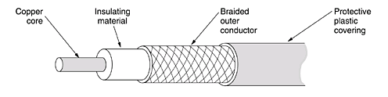
Coaxial cable
A coaxial cable consists of a stiff copper wire as the core, surrounded by an insulating material. The insulator is encased by a cylindrical conductor, often as a closely woven braided mesh. The outer conductor is covered in a protective plastic sheath (Diameter of 1cm to 2.5cm)
The construction and shielding of the coaxial cable give it a good combination of high bandwidth and excellent noise immunity. The bandwidth possible depends on the cable quality and length.
50 ohm: used for digital signal
75 ohm: used for analog transmission and cable television

Slide 28
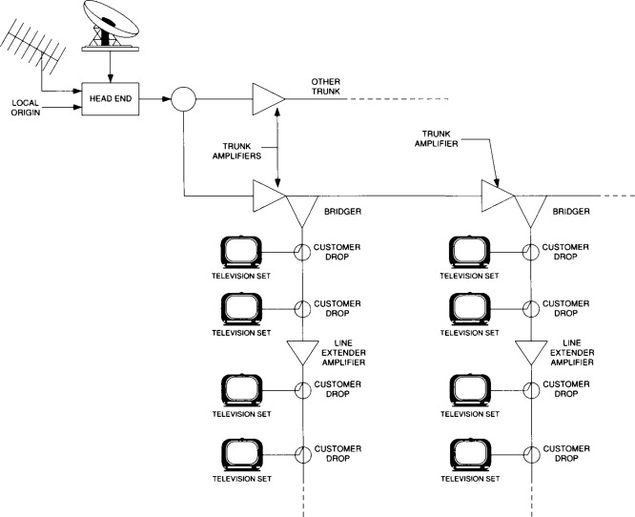
Cable TV system

Slide 29
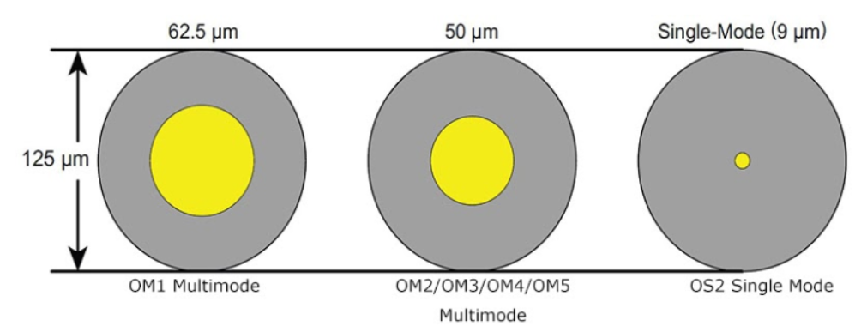
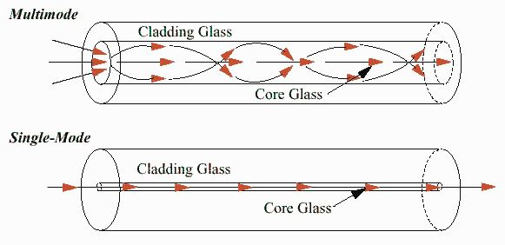
Fiber Optics
At the center is the glass core through which the light propagates. In multimode fibers, the core is typically 50 microns in diameter, about the thickness of a human hair. In single-mode fibers, the core is 8 to 10 microns.

Slide 30
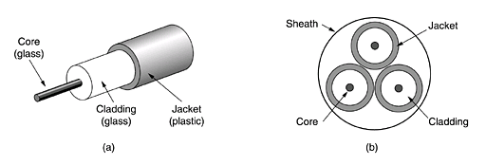
Fiber Optics
The core is surrounded by a glass cladding with a lower index of refraction than the core, to keep all the light in the core. Next comes a thin plastic jacket to protect the cladding.
Fibers are typically grouped in bundles, protected by an outer sheath.

Slide 31
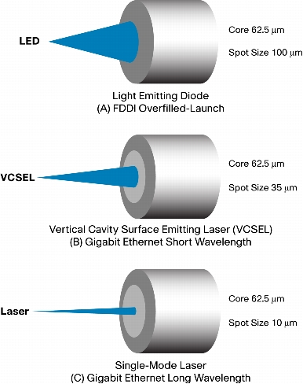
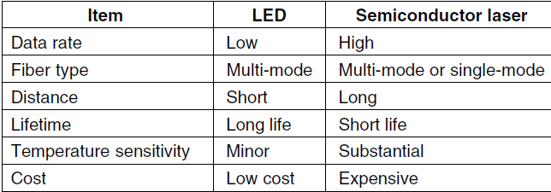
Light sources
Two kinds of light sources
LEDs (Light Emitting Diodes)
Semiconductor lasers.

Slide 32
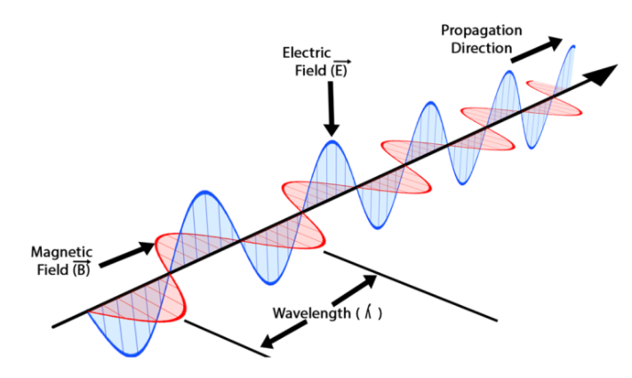

Wireless transmission
When electrons move, they create electromagnetic waves that can propagate through space (predicted by James Clerk Maxwell 1865, first observed by Heinrich Hertz in 1887)
$$λ=\frac{c}{f}$$
The speed of light, c, is approximately
3 × 10⁸ m/sec
The number of oscillations per second of a
wave is called its frequency, f, in Hz
Hertz).
The distance between two consecutive maxima (or minima) is called the wavelength, λ.
Notes:
Optional

Slide 33
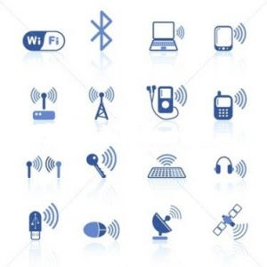
Wireless transmission
Advantages of wireless transmission
Mobility
Suitable for any terrain areas
Easy for maintenance
Quick deployment
Wireless transmission types
Radio
AM, FM, …
Wi-Fi
Microwave
Infrared
Optics

Slide 34
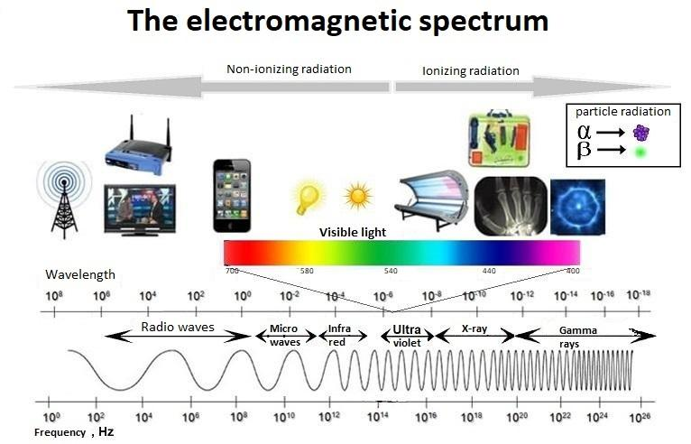
Wireless transmission

Slide 35
Licensed vs. Unlicensed Spectrum
Licensed Spectrum:
Need to buy right to use spectrum allocation in a specific geographic
location from the government.
Prevents interference – licensee can control signal quality
e.g.: GSM Frequency Spectrum.
Unlicensed Spectrum
Anyone can operate in the spectrum
Can have interference problems
e.g.: ISM-Band: Industrial, Scientific and Medical frequency band
2.4 GHz
e.g. : Wi-Fi uses ISM band
Wireless and Mobile Networks
32

Slide 36
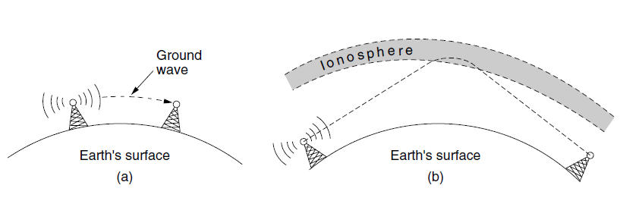
Wireless transmission
In the VLF, LF, and MF bands, radio waves follow the ground.
In the HF and VHF bands, the ground waves tend to be absorbed by the earth.
However, the waves that reach the ionosphere, a layer of charged particles circling
the earth at a height of 100 to 500 km, are refracted by it and sent back to earth

Slide 37
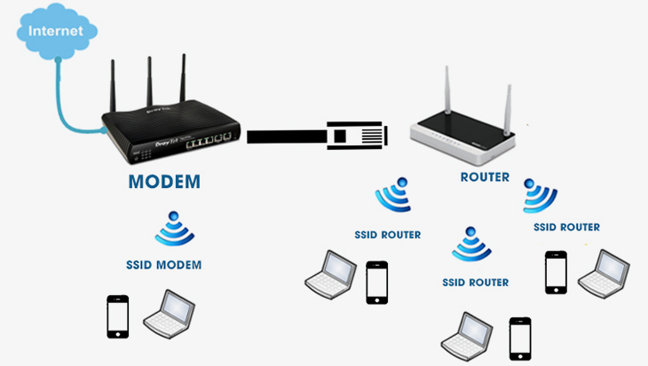
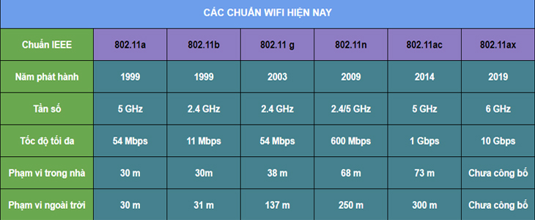
RF: Wi-Fi (IEEE 802.11)
Radio Frequency (RF)
2.4GHz
5.0 GHz

Slide 38
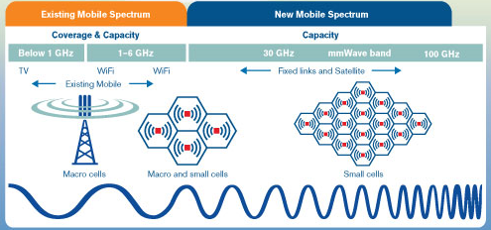
4G/5G
New Radio (NR) spectrum
﻿Increased bandwidth with millimeter waves
Massive Multiple Input – Multiple Output (MIMO)
﻿Using multiple transmit and receive antennas to take advantage of multipath propagation

Slide 39
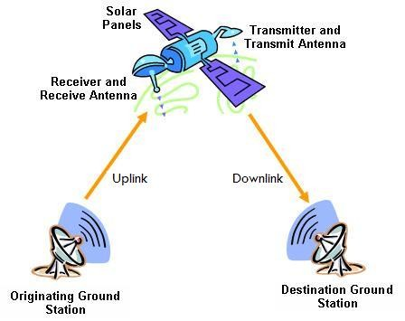
Satellite communication
Description of communication satellite
Microwave relay station
Used to link two or more ground-based microwave transmitter/receivers
Receives transmissions on one frequency band (uplink), amplifies or repeats the signal, and transmits it on another frequency (downlink)
A single orbiting satellite will operate on a number of frequency bands, called transponder channels, or simply transponders.
Applications
Television distribution
Long-distance telephone transmission
Private business networks
Optimum Freq. Range: 1 – 10 GHZ
Wireless and Mobile Networks
36

Slide 40
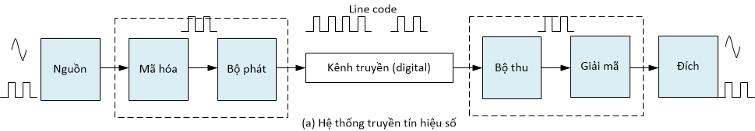
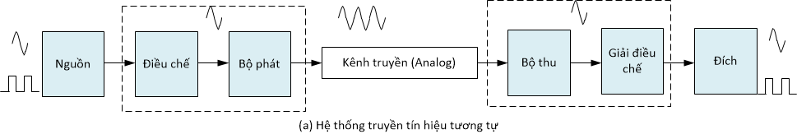
2.4. Line coding
Digitization data
Sources: analog/digital -> digitization
Encoding: convert into line codes for transmitting
Unipolar, Polar, Bi-polar line codes
Digital
transmission
Analog
transmission
Line codes that help with bandwidth efficiency, clock recovery, and DC balance.

Slide 41
2.4 Why line coding?
There should be self-synchronizing i.e., both receiver and sender clock should be synchronized. It requires clock recovery.
There should be no (low frequency) DC-component as long distance transfer is not feasible for DC-component signal.
There should be bandwidth efficiency since the channel capacity is limited
There should have some error-detecting capability.
There should be immunity to noise and interference.
There should be less complexity.
There should be less base line wandering.

Slide 42
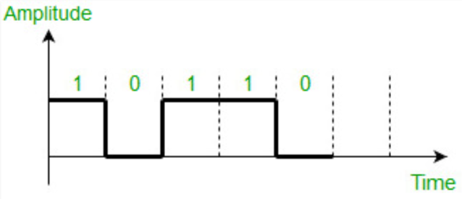
2.4. Line codes
Unipolar (line code)
NRZ
‘1’: positive
‘0’: zero
Signal does not return to zero at the middle of the bit, thus it is called NRZ.
Advantages
Simple
Lesser BW required
Disadvantages
No error correction done.
Presence of low frequency components may cause the signal droop.
No clock is present.
Loss of synchronization is likely to occur (especially for long strings of 1s and 0s).
Notes:
AMI Alternate Mark Inversion

Slide 43
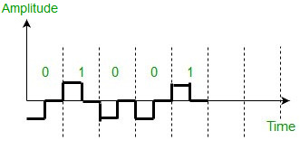
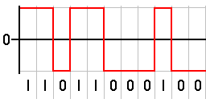
2.4. Line codes (2)
Polar
RZ
NRZ
‘1’: positive + zero
‘0’: negative + zero
‘1’: positive
‘0’: negative
Advantages
It is simple.
No low-frequency components are present.
Disadvantages
No error correction.
No clock is present.
The signal droop is caused at the places where the signal is non-zero at 0 Hz.

Slide 44
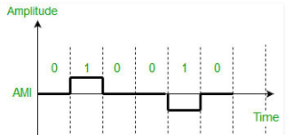
2.4. Line codes (3)
Bipolar
AMI
‘1’: positive - negative
‘0’: zero
Advantages
It is simple.
No low-frequency components are present.
Occupies low bandwidth than unipolar and polar NRZ schemes.
This technique is suitable for transmission over AC coupled lines, as signal drooping doesn’t occur here.
A single error detection capability is present in this.
Disadvantages
No clock is present.
Long strings of data causes loss of synchronization.

Slide 45
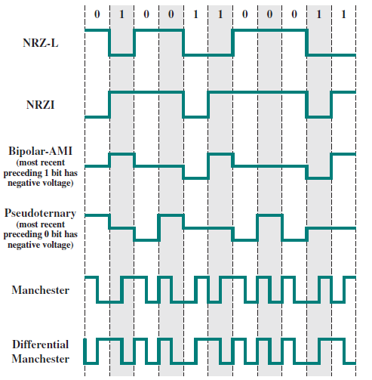
2.4. Line codes (4)
Popular line codes
NRZ-L;
NRZ-I;
RZ;
Manchester
Etc.

Slide 46
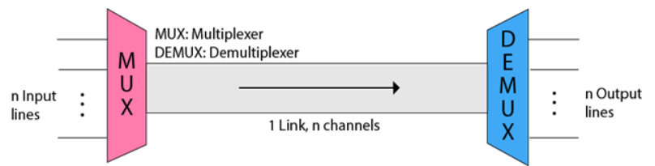
2.5 Multiplexing/De-multiplexing
Why need multiplexing?
The medium can only have one signal at a time.
There are multiple signals to share one medium.
There is a possibility of collision.
Transmission services are very expensive
The two basic types of multiplexing techniques:
Time division multiplexing (TDM)
Frequency division multiplexing (FDM)
In optical information, wavelength division multiplexing (WDM) is also the FDM.

Slide 47
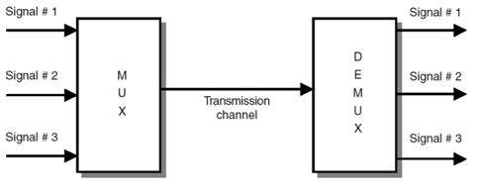
2.5 Multiplexing/De-multiplexing
Multiplexing techniques are used only when the bandwidth of the transmission channel is higher than the bandwidth of data sources.
E.g: the signals from three sources can be combined (multiplex) and sent over a single channel. At the receiving end, the combined signals are separated into 3 separated original signals.

Slide 48


Frequency Division Multiplexing
In the FDM, the signals are shifted into different frequency ranges and sent through the media. Communication channels are divided into different bands, and each signal transmission band corresponds to one source.

Slide 49


Time Division Multiplexing
Trong TDM, các tín hiệu số hóa được kết hợp và gửi thông qua các kênh truyền thông. .

Slide 50
Summary
Basic knowledge of data communication system
Digitization forms of information
Distinguish and calculate quantities related to the characteristics of a transmission channel such as bandwidth, frequency, data rate, noise, capacity and throughput of a transmission channel
Describe and understand line codes
Multiplexing/de-multiplexing techniques

